Slide 1


Slide 2

SCHOOL MANAGEMENT
SYSTEM
GROUP MEMBERS:
HAMZA ASLAM, HAMMAD ASIF, AHMAD RAZI
BILAL FAREED

Slide 3
INTRO TO OUR PROJECT
Today all the work at the time of admission of the students is done manually by ink and paper, which is very slow and consuming much efforts and time. In the modern world of technology, computer are affecting our lives in more ways than we probably are aware of COMPUTERIZED MANAGEMENT maintaining information of an educational institute, colleges, other the list is endless.

Slide 4
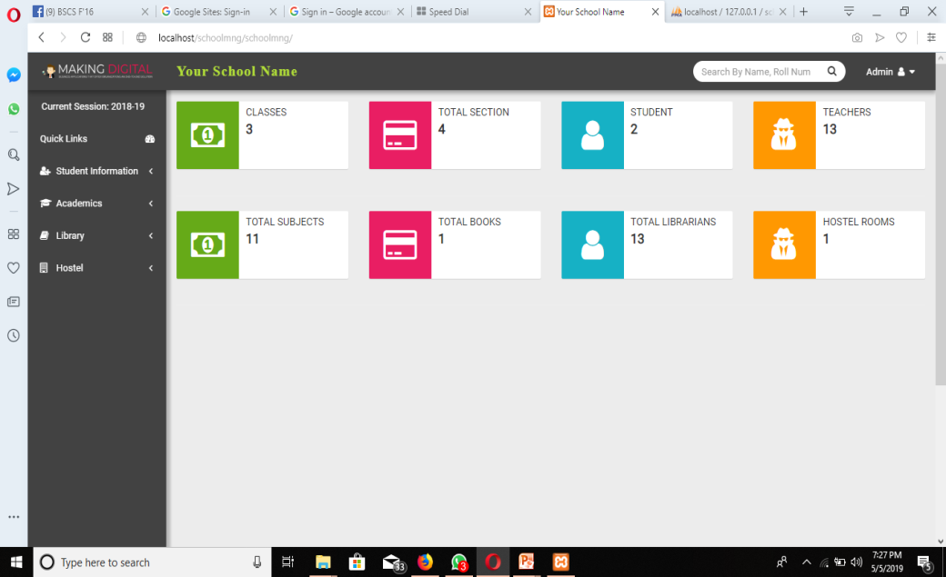
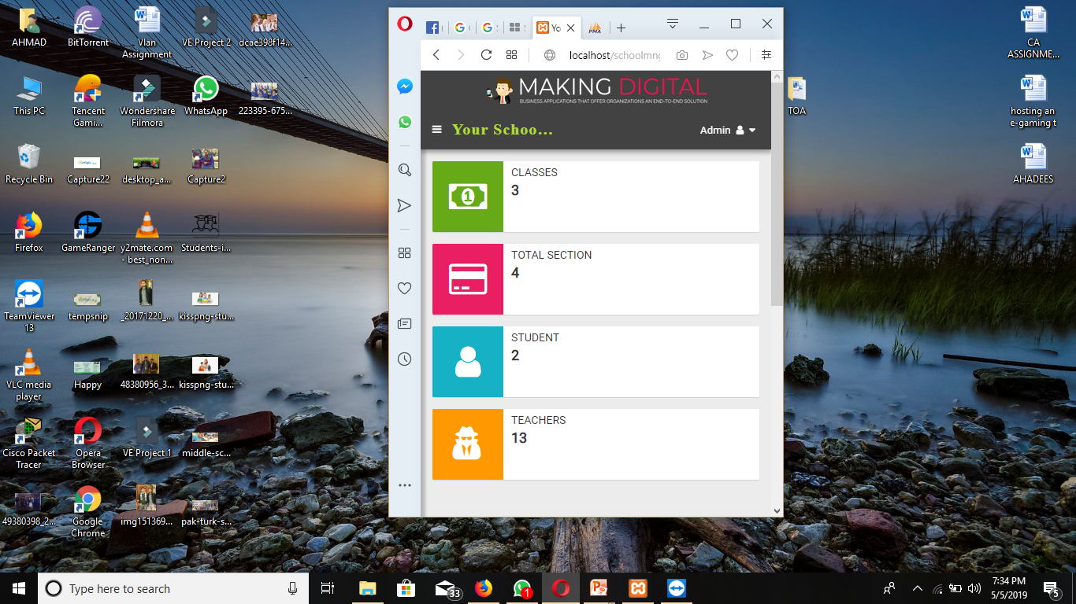
HAVE A LOOK!!!
ON MOBILE PHONE
ON PERSONAL COMPUTER

Slide 5



MODULES
ACADEMICS
LIBRARY
Class time table, Add Teachers, Add Subjects, Assign Subjects, Make class, add sections
Add Book, List Books, Issue Return, Add Teacher, Add Student.
STUDENT INFORMATION
HOSTEL
Students Detail, Student Information, Student Admission, Promote Students.
Add Rooms, Room Type, Hostel

Slide 6
SOME FEATURES
STUDENT ADMISSION
New students are added to school through student admission feature.
01
VIEW STUDENTS DETAILS
Admitted student’s data can be viewed through view student details.
02
ADD TEACHERS
New teachers are added through add teachers.
03
ASSIGN SUBJECTS
Subjects can be allotted to teachers through assign subjects.
QUICK LINKS
Quick links provide links for important features in the web incase if some feature is needed in hurry.
04
05

Slide 7
SOME FEATURES (CONTI..)
DESIGN CLASS TIME TABLES
New class time table can be made for teachers and students using class time table.
VIEW CLASS TIME TABLES
Created time table can be viewed by teachers and students through view class time table.
ADD CLASSES
New classes can be added through add class.
ADD CLASS SECTIONS
New sections in a created class can be added through add class section.
ADD HOSTEL ROOMS & ROOM TYPES
In Hostel module new rooms can be added through add room. And then categories of inserted rooms can be added through room type.

Slide 8
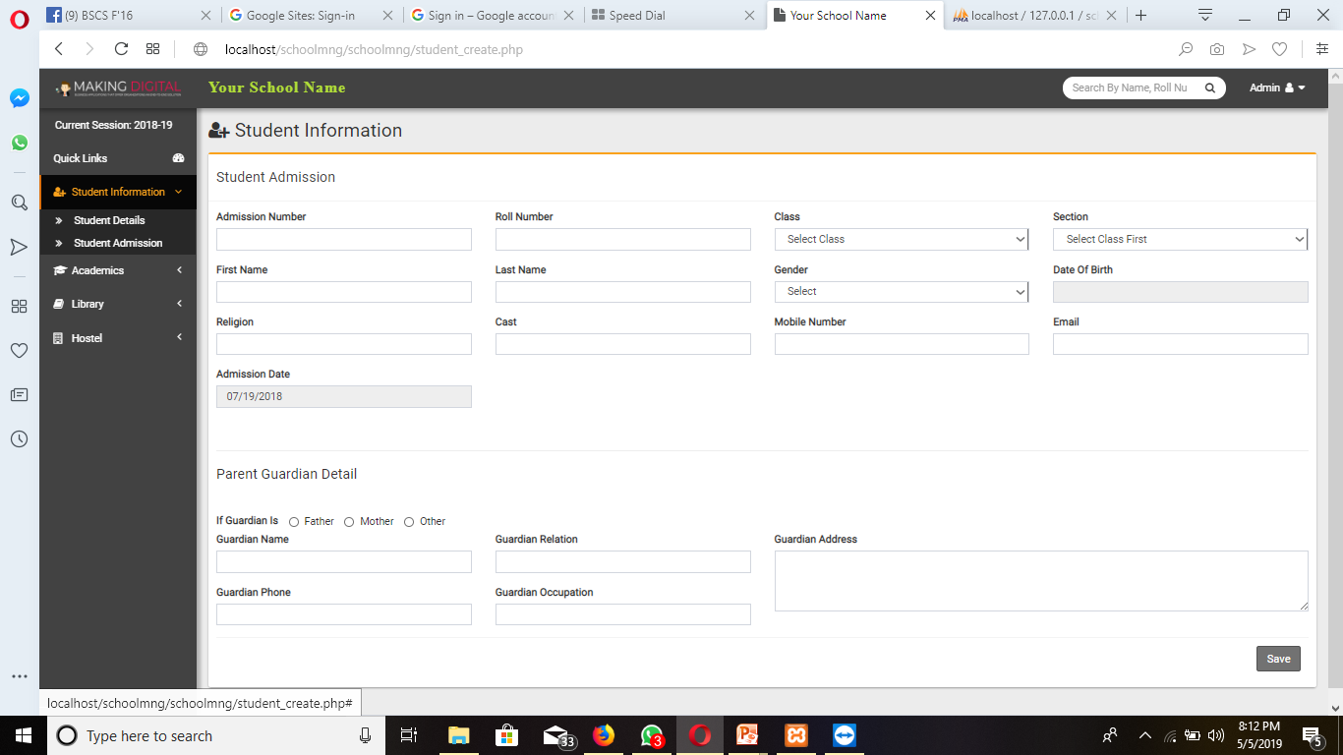
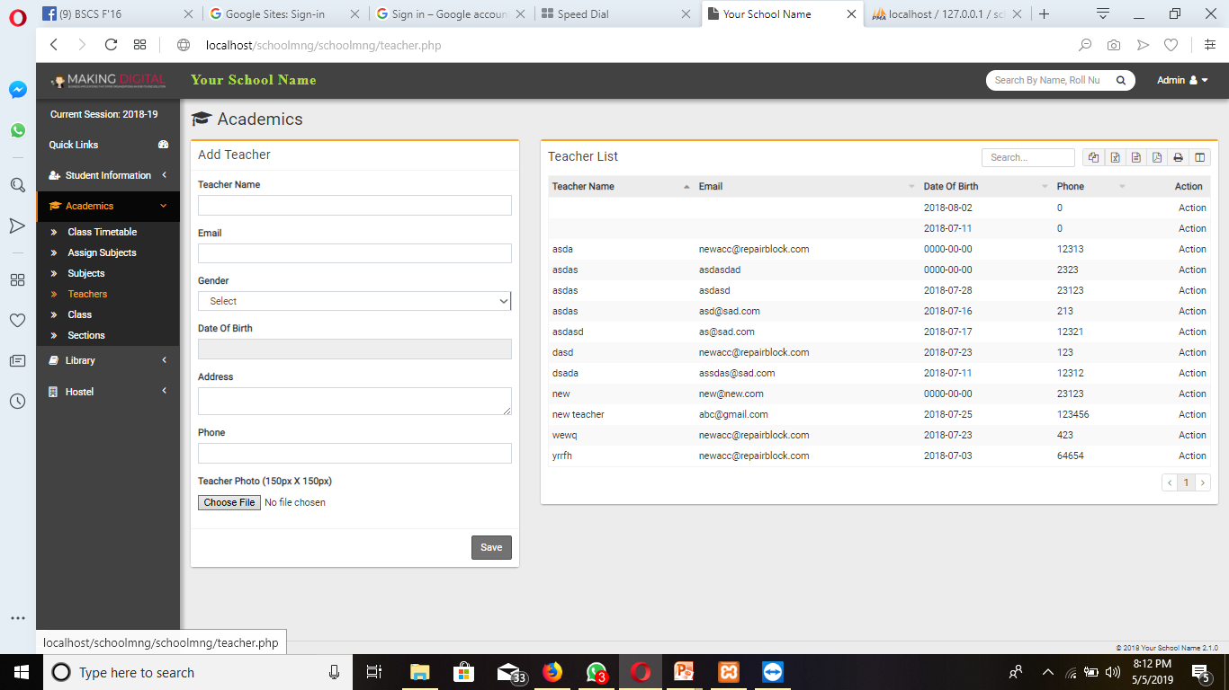
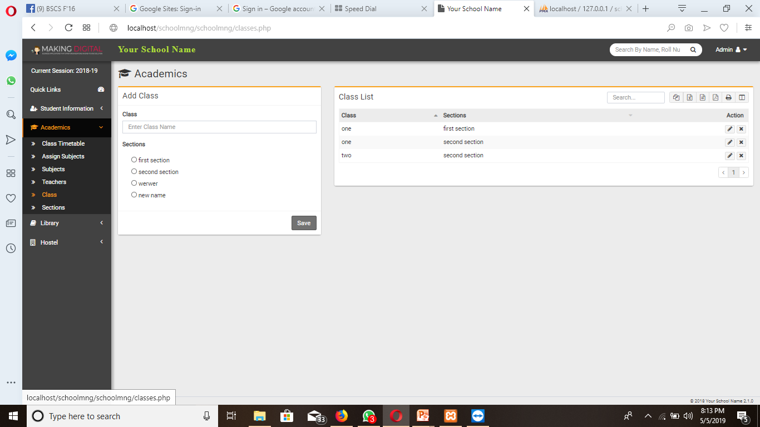
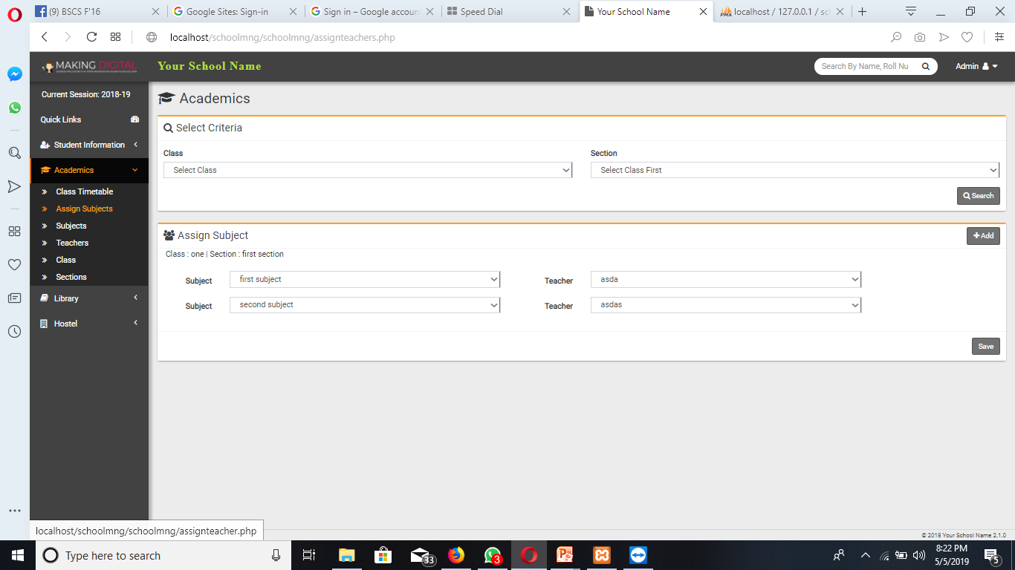
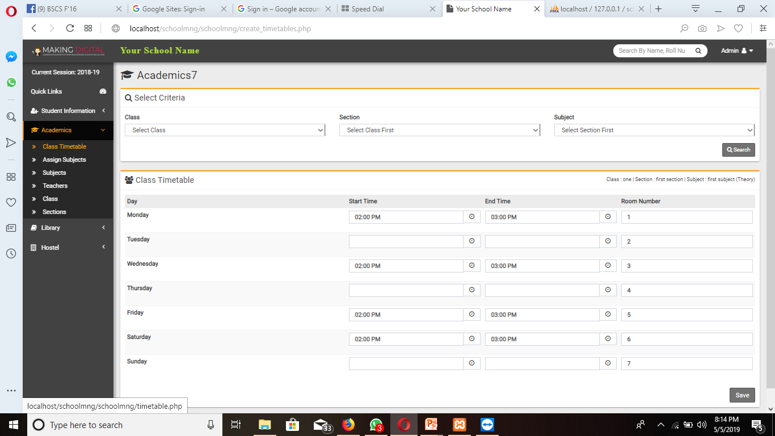
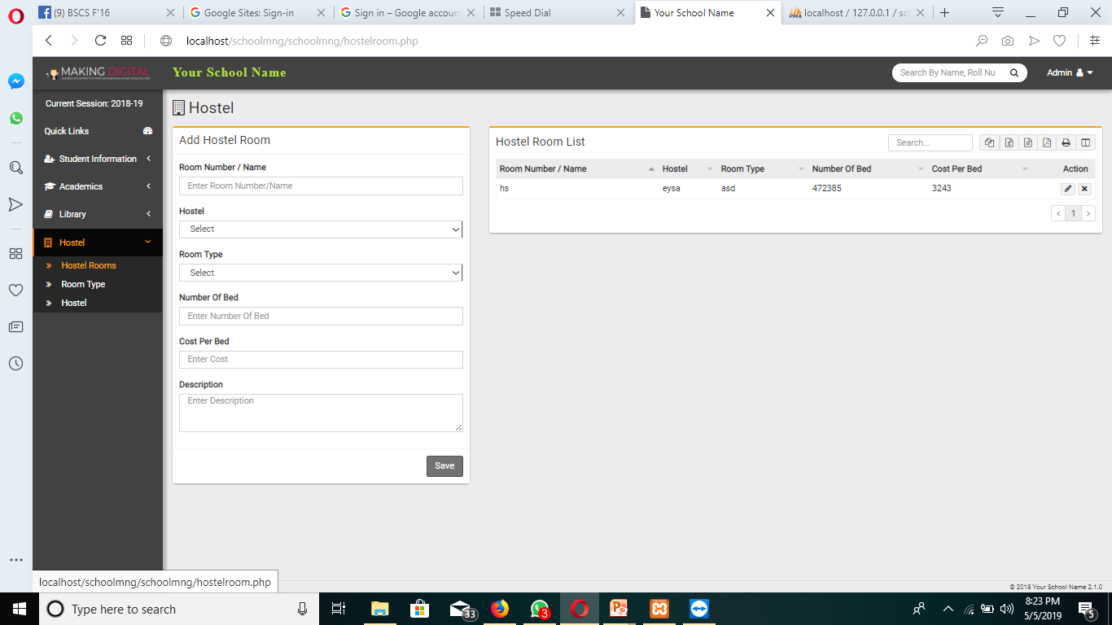
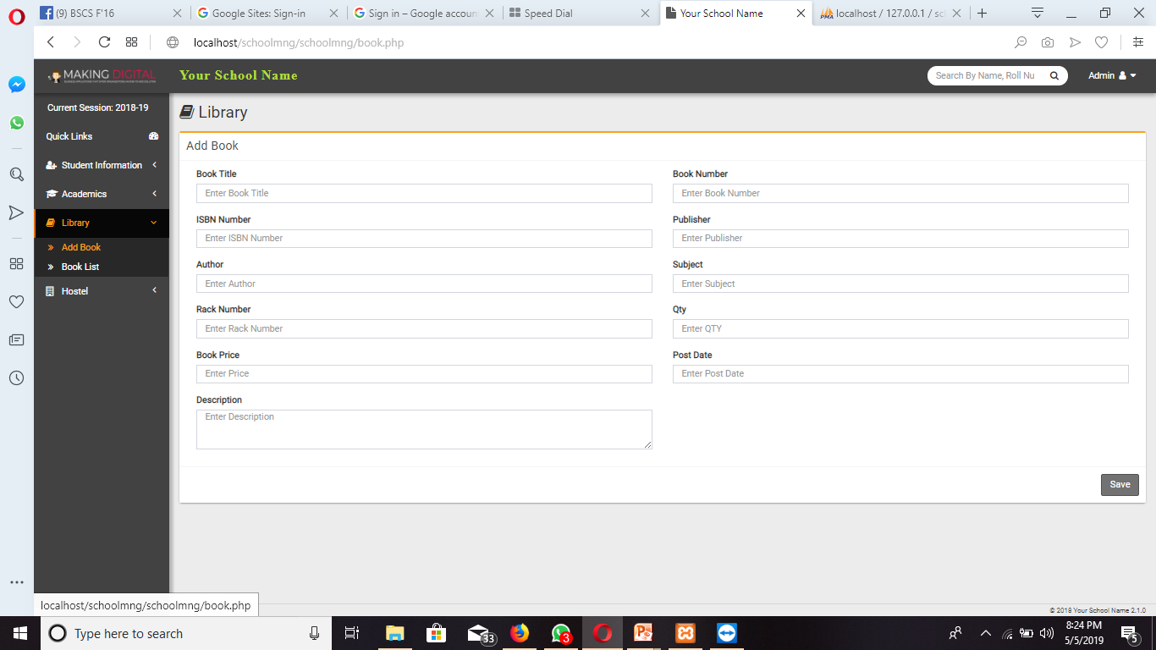
SCOPE OF OUR WORK
The purpose of any new technology is to make people life easier. Allows the administrators to register the daily required information of Students, Teachers & office staff.School Management System will organize work inside schoo proposed system will do the following tasks:
Insert student’s information such as student name, student number, address etc.
Insert Teacher information such as Teacher name, number, address etc.
Insert class and section’s information such as section number and class name.
Design time table view time table.
Assign subjects to teachers i.e maths to some teacher.
Add hostel rooms and there categories i.e room name, id, type etc
Add books with information such as book name, book id etc.

Slide 9
Languages Used
Html, Bootstrap(Css)
For developing web pages and designing of developed web pages.
Php, Javascript, Ajax
For backend development we used these languages.
My SQLi
D
D
D
For storing data of forms. we used this languages.
D
D

Slide 10
Thank You
Any Questions !!!

